Slide 1
Image Localization Using Machine Learning
Riti Gupta
Fall 2019
CS 298 Project
Advisor :
Dr. Christopher Pollett
Committee :
Dr. Robert Chun
Dr. Kong Li

Slide 2
Agenda
Introduction
What is image localization
Current approach and suggested approach
Use case scenarios
Background
Design and Implementation
Experimental Results
Conclusion

Slide 3
PROBLEM

Slide 4
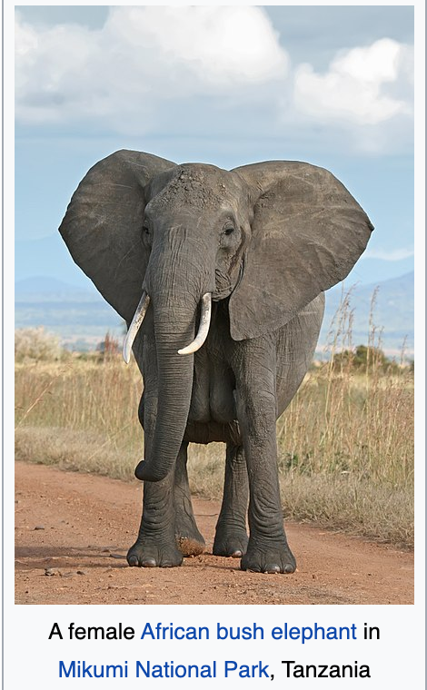
Image Localization
Translation of text in image from one language to other language
Focus on image captional text in this project
English Text

Slide 5
Image Localization
Translation of text in image from one language to other language
Focus on image captional text in this project
English Text

Slide 6
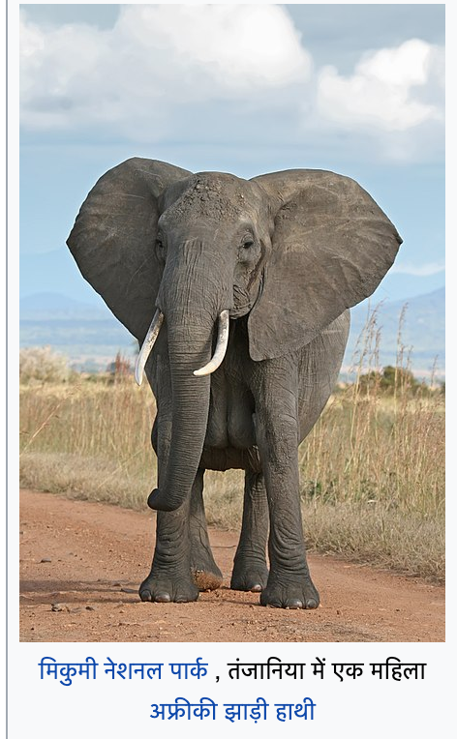
Image Localization
Translation of text in image from one language to other language
Focus on image captional text in this project
English Text
Hindi Text

Slide 7
INTRODUCTION

Slide 8
Current Approaches
Extract the text from the images and perform translation
Focus on the text in images
Many applications available for image translation
Google Translate [22]
Microsoft Translator [30]
Notes:
Some of the popularly used applications are

Slide 9
Approaches Researched
Approaches Researched
Approach 1: Translation using pixel to pixel transformation.
Detect edges, shapes, and objects (Naïve approach. Not practically used)
Approach 2: Translation using image text and image context
Extract image text and image context (objects and surroundings in image)
Focus on “Approach 2” for this project
Notes:
Can mention about CNNs in Approach 1. Say that I will explain contextual information on next slide

Slide 10
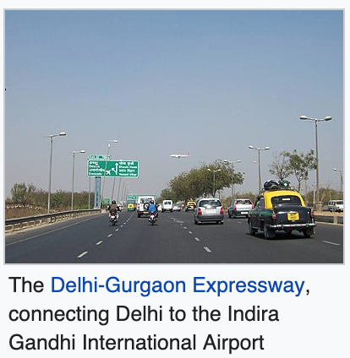
Example
Textual information: The Delhi-Gurgaon Expressway, connecting Delhi to the Indira Gandhi International Airport
Contextual information: road, motor vehicle, lane, asphalt, highway, transport, mode of transport, infrastructure, thoroughfare, sky

Slide 11
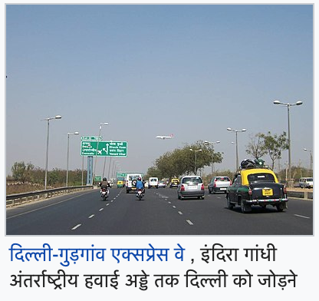
Example
Textual information: The Delhi-Gurgaon Expressway, connecting Delhi to the Indira Gandhi International Airport
Contextual information: road, motor vehicle, lane, asphalt, highway, transport, mode of transport, infrastructure, thoroughfare, sky

Slide 12
Flowchart of Technique Used
Input : Image In ‘English’
Extract the text in ‘English’
Extract the context in ‘English’
Machine Learning Model
Output : Image In ‘Hindi’

Slide 13
MOTIVATION

Slide 14
Usage Scenarios
Traveler reading posters and boards in foreign language
Context can be current time, temperature, and location
Understanding similar words
Bark (tree’s branch or dog’s growl)
Sea (ocean) and See (watch)
Translating old manuscripts
Context can be pictures of old weapons and instruments
Notes:
There can be many more examples apart from these.

Slide 15
BACKGROUND

Slide 16
Techniques Needed For The Project
Neural Networks
Recurrent Neural Networks (RNN)
Sequence Translation Using RNN
Text Extraction
Image Captioning

Slide 17
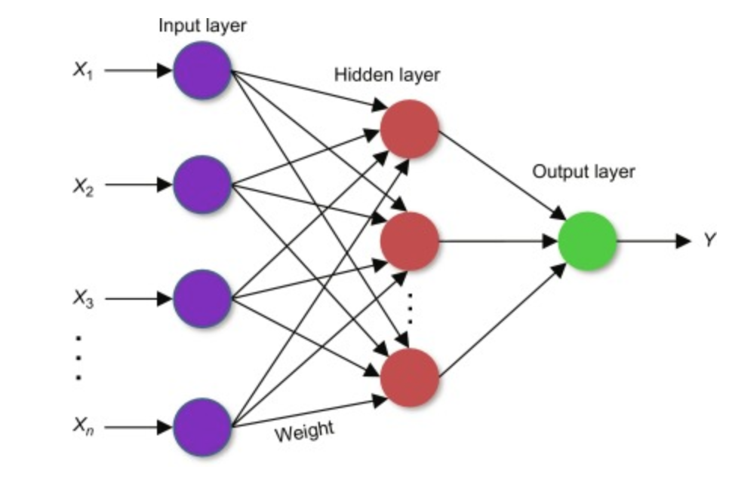
Neural Networks
Composed of multiple layers containing multiple neurons
Input layers takes in the input
Hidden layers performs mathematical calculations on input
Output layers output a number based on which prediction is done
Notes:
Mention that weights and biases keep improving with each example that is passed

Slide 18
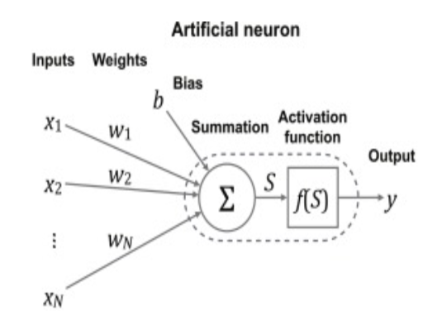
How does a neuron work
Computes output by performing mathematical computation using inputs, weights, bias and activation functions
S = x₁.w₁ + x₂.w₂+….+ x_{n}.w_{n} + b
Notes:
Mention that the loss is calculated by computing the deviation from the correct output. The error is backpropagated so that the model can improve by adjusting weights and biases accordingly.

Slide 19
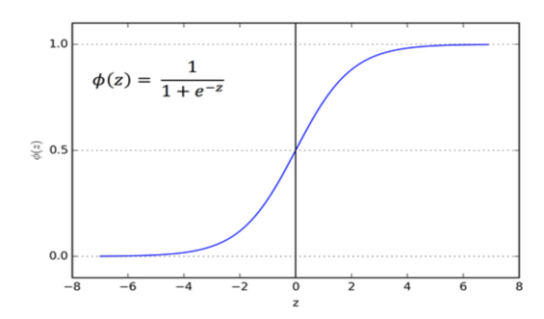
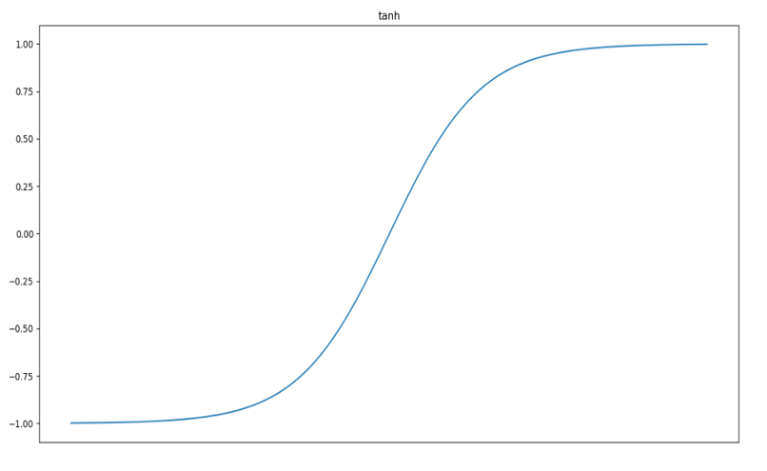
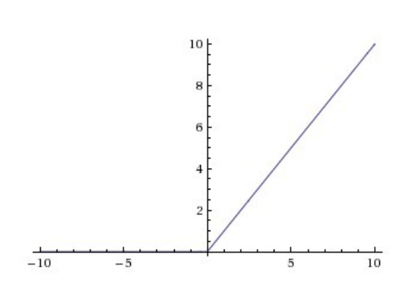
Activation Functions
Output of the neuron decided based on the activation function
Activation function introduce non-linearity and transform big values to small values
Function decided based on the type of problem
Sigmoid, relu and tanh are the popular ones
Sigmoid
Tanh
ReLu

Slide 20
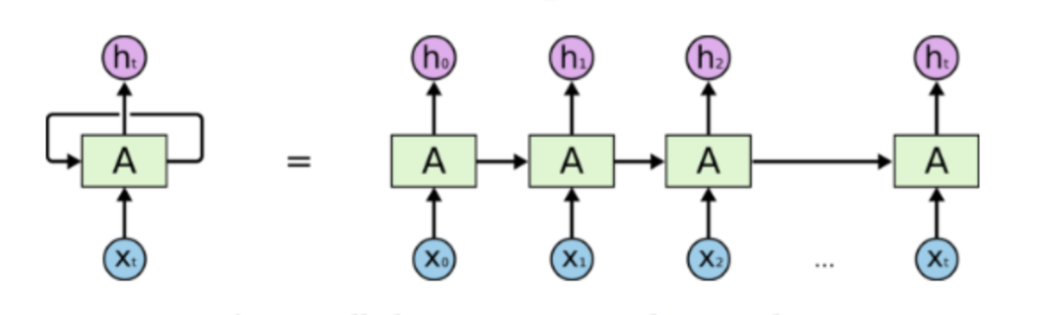
Recurrent Neural Networks
Used to take advantage of previous knowledge to develop new understanding
While watching the movie, we remember the earlier events which helps in understanding rest of the movie
LSTMs – selectively stores the relevant information [26]

Slide 21
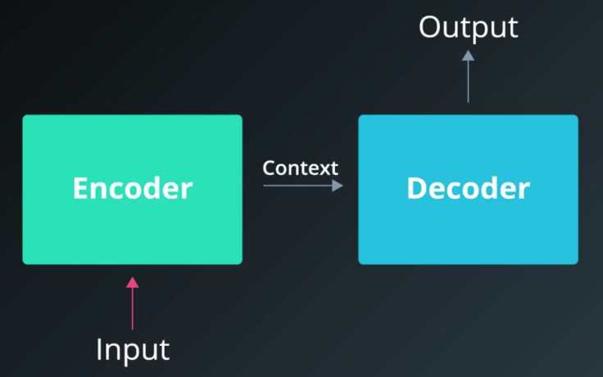
Sequence to Sequence transformation with RNN
Will discuss widely used model viz. “Encoder Decoder” [19]
Encoder and Decoder composed of RNN neurons
Encoder understands the context and passes it
Decoder generates the output with the help of context

Slide 22
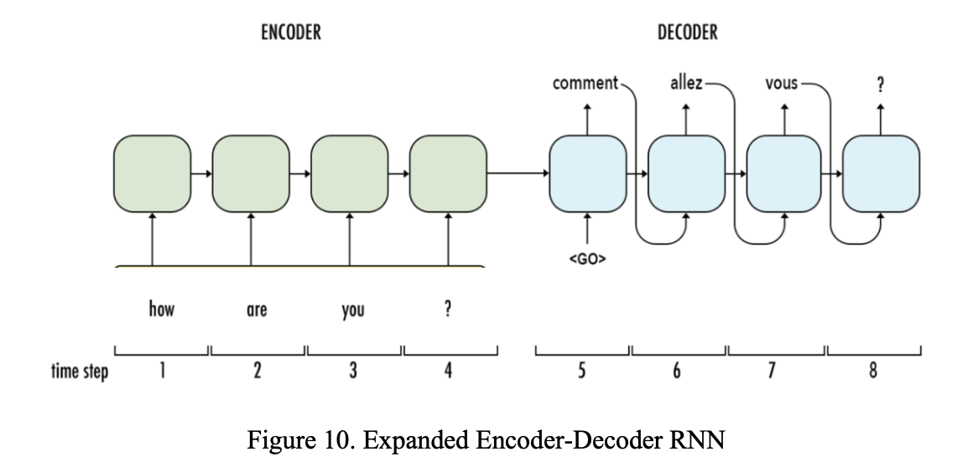
Expanded Encoder-Decoder RNN
Encoder neuron takes input and previous context to predict next context
Decoder neuron takes previous output and previous context to predict output and context

Slide 23
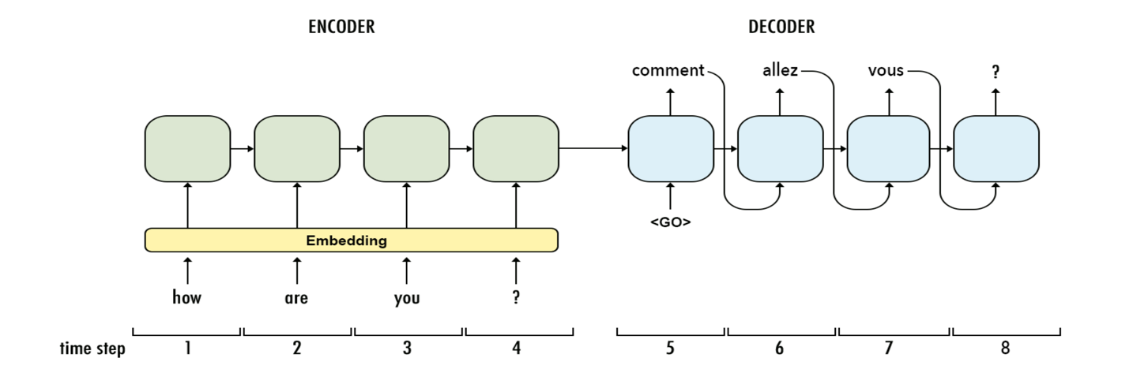
Encoder-Decoder RNN with Embedding Layer
Embedding represents each word in the form of integer vector
Similar words have similar vectors
‘Car’ and ‘Truck’ close to each other
‘United States’ and ‘Car’ would be farther as they are not related
Can help RNN learn useful context
Notes:
Helps in generation of good context. Advantages over OHE

Slide 24
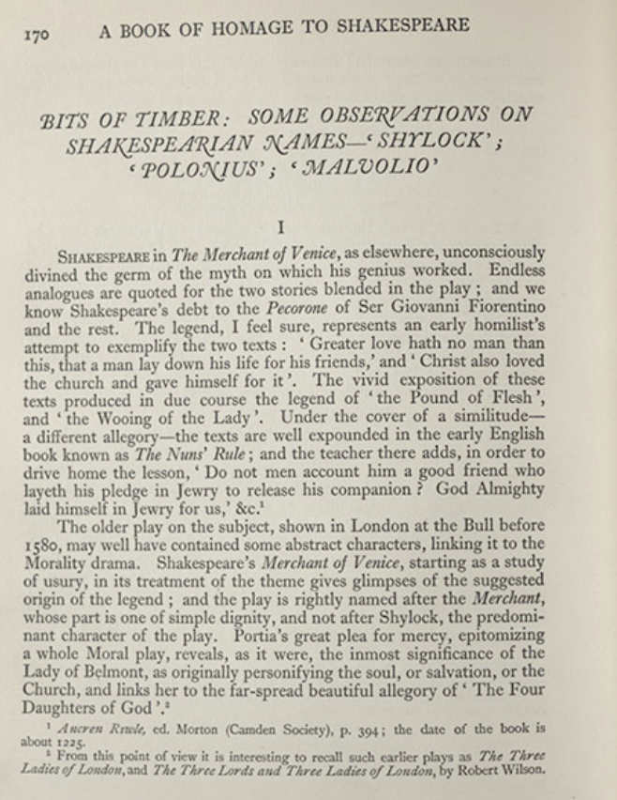
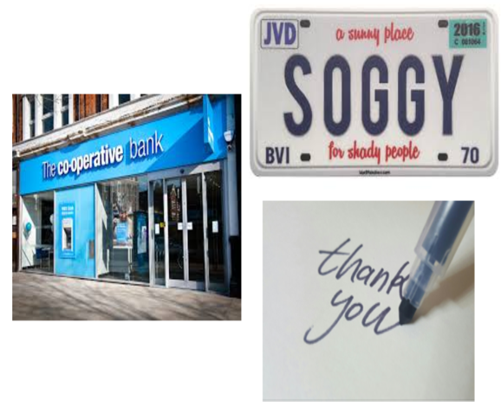
Text Extraction
Image preprocessed before text extraction
Remove noise
Convert to black and white
Detect textual regions using windows [2] or CNNs [7]
Textual features and regions passed to RNN to extract text
Text extraction from unstructured text more challenging
Various tools available
Optical Character Recognition
Tesseract [28]
Google Cloud Vision
Structured Text : Uniformly Formatted Text
Unstructured Text : Varying text font and size
Notes:
Machine learning models used with OCR

Slide 25
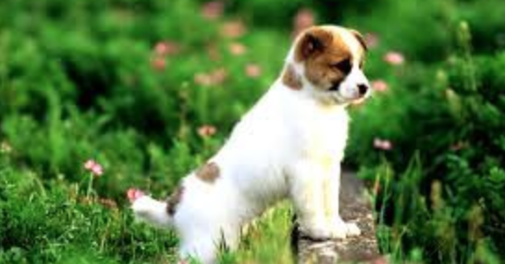
Image Captioning
The context of the image required for the project can be generated through image captioning techniques
Image Captioning : process of understanding the image and generate labels for it.
Tools available :
Google Cloud Vision [29]
Microsoft Caption Bot [30]
White dog sitting in grassy area

Slide 26
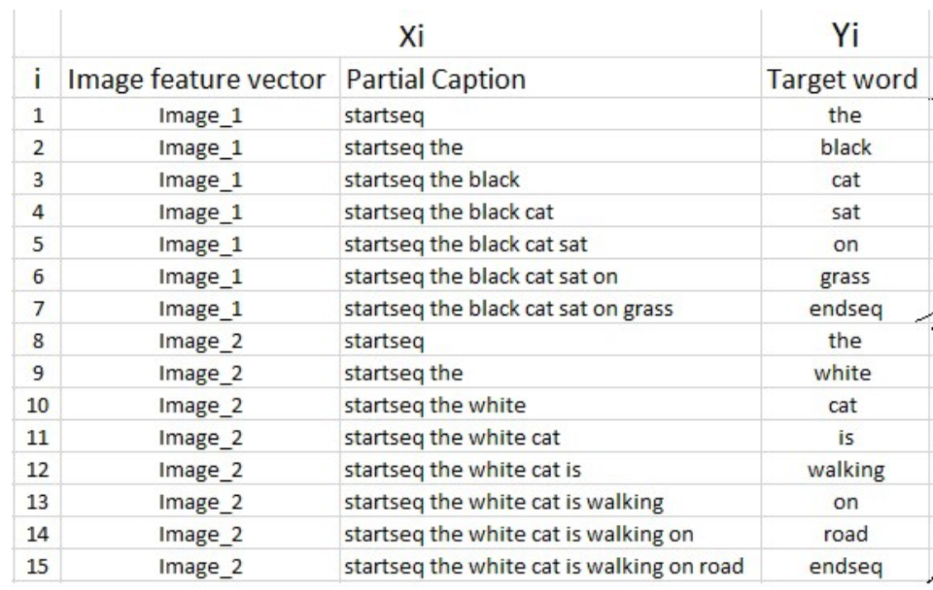
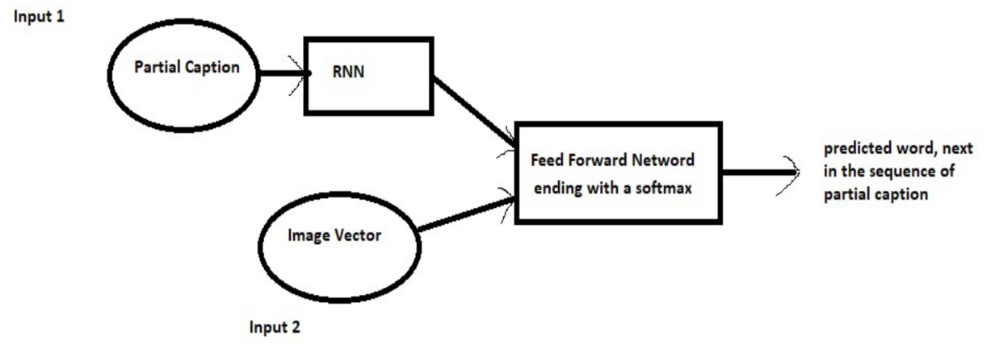
Image Captioning Technique [18] [20]
Generate the feature vector using CNN
Train the model using feature vector and the sequences available
Context of the sequences generated using RNNs
Generation of next word in sequence
Image Captioning Model Architecture
Notes:
In case of 18 they used…dataset

Slide 27
DESIGN AND IMPLEMENTATION

Slide 28
Environment Used
Programming Language : Python 3.6.8
Neural Network Library : Keras 2.2.5 (used TensorFlow 1.15.0 as backend)
IDE : Google Colaboratory [31]
Google Cloud Vision APIs [29]
Text Extraction
Image Context

Slide 29
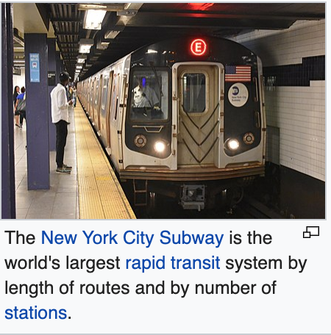
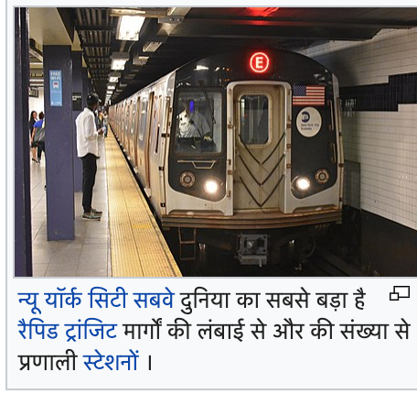
Dataset
10,000 pairs of English and corresponding Hindi image.
Collected manually by taking snapshots from Wikipedia

Slide 30


Challenges in Dataset Collection
Automatic Web Crawling through scripts did not work.
Not all pages translated to Hindi
Snapshot size cannot be determined as all languages have different font sizes
English and Hindi consume different fractions of line.

Slide 31
FLOWCHARTS

Slide 32
Model training using ‘context’ of the images.
Dataset images
Extract text from images in ‘English’ using Google API’s.
Populate ‘English’ column of csv file.
Extract the context of images using Google API’s.
Populate the ‘context’ column of csv file.
Extract text from images in ‘Hindi’ using Google API’s.
Populate ‘Hindi’ column of csv file.
Build the training input by concatenating ’English’ + <START> + ‘context’ columns.
The ‘Hindi’ column acts as the label of the dataset.
Train the model.

Slide 33
Predictions using the model trained with ‘context’.
Test images dataset
Extract text from images in ‘English’ using Google API’s.
Populate ‘English’ column of csv file.
Extract the context of images using Google API’s.
Populate the ‘context’ column of csv file.
Build the input by concatenating ’English’ + <START> + ‘context’ columns.
Predict using the model.
Compute the accuracy using human translations and comparing with model translations.

Slide 34
Model training without using ‘context’ of the images.
Dataset images
Extract text from images in ‘English’ using Google API’s.
Populate ‘English’ column of csv file.
Extract text from images in ‘Hindi’ using Google API’s.
Populate ‘Hindi’ column of csv file.
Build the training input using ’English’ column.
The ‘Hindi’ column acts as the label of the dataset.
Train the model.

Slide 35
Predictions using the model trained without ‘context’.
Test images dataset
Extract text from images in ‘English’ using Google API’s.
Populate ‘English’ column of csv file.
Build the input using ’English’ column.
Predict using the model.
Compute the accuracy using human translations and comparing with model translations.

Slide 36
Data Preprocessing
Convert to lower case
Count total and unique words
Tokenize the sequences.
This makes the training of deep learning model efficient by converting the data into a simplified format.
Pad the sequences with number zero to make all the inputs of equal size.
Equal sized inputs make matrix multiplications simpler for the training of neural network.

Slide 37
MODEL ARCHITECTURE
Input sequence
Word Embedding (Lookup)
Word vector
Recurrent Layer(s)
Time Distributed Layers
Dropout Layers
Dense Layer(s)
Output sequence
Calculate Cross Entropy Loss and backpropagate the error

Slide 38
Other Details
Self trained the embedding layer
Also experimented with GRU [32]
Activation Functions Used
Output Layer : Softmax
Hidden Layers : ReLu
Optimization Function: Adam [33]
Number of Epochs : 2000
Time Taken : 18 hours

Slide 39
EXPERIMENTAL RESULTS - Individual Predictions - Overall Statistics

Slide 40
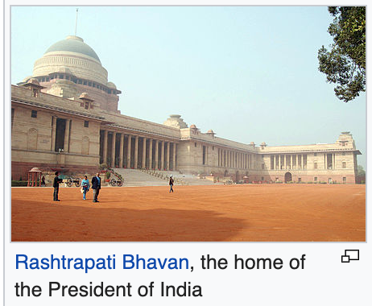
Test Data 1
Input Text: rashtrapati bhavan, the home of the president of india
Image Context: landmark, holy places, architecture, tourist attraction, historic site, building, adaptation, tourism, stock photography, photography
“ भारत के राष्ट्रपति का घर राष्ट्रपति भवन ”
Correct Translation

Slide 41
Test Data 2
Input Text: the delhi-gurgaon expressway, connecting delhi to the Indira gandhi international airport
Image Context: road, motor vehicle, lane, asphalt, highway, transport, mode of transport, infrastructure, thoroughfare, sky
“दिल्ली-गुड़गांव एक्सप्रेस वे , इंदिरा गांधी अंतर्राष्ट्रीय हवाई अड्डे तक दिल्ली को जोड़ने ”
Correct Translation

Slide 42
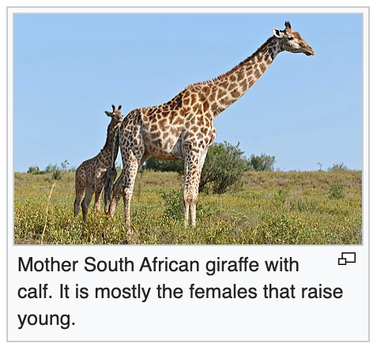
Test Data 3 (comparison with and without context)
Input Text: mother south african giraffe with calf. it is mostly the females that raise young.
Image Context giraffe, terrestrial animal, wildlife, giraffidae, vertebrate, nature reserve, grassland, adaptation, natural environment, ecoregion
Prediction with The Image Context: माँ क्षेत्र जिराफ जिराफ़ साथ साथ 21 के लिए लॉर्ड और के बेचे से विभाजित
Prediction without the Image Context: की अनुसंधान का भारत के साथ जयते सलाहकार नक्शे स्नान के के लिए में जाती है।
Both Incorrect.
partial information detected with context (translates the Giraffes and mother).
Without context, all words incorrect.

Slide 43
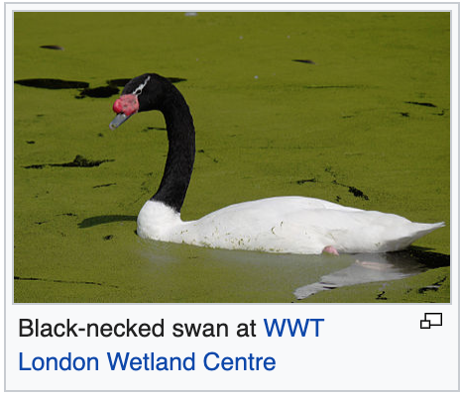
Test Data 4 (comparison with and without context)
Input Text: black-necked swan at wwt london wetland centre
Image Context: bird, vertebrate, swan, ducks, geese and swans, waterfowl, beak, duck, black
Prediction with The Image Context: लंदन वेटलैंड सेंटर में काले गले वाला हंस
Prediction without the Image Context: लंदन वेटलैंड सेंटर में गले वाला हंस
Model trained without the context missed translating the black color.

Slide 44
Overall Statistics
Percentage of correct translations are higher when image context is considered.
Partial predictions are considerably better with the context
 | CONTEXT | WITHOUT CONTEXT
% CORRECT | 0.70 | 0.66
% PARTIALLY CORRECT | 0.25 | 0.13
% INCORRECT | 0.05 | 0.21
Accuracy statistics with and without using the image context

Slide 45
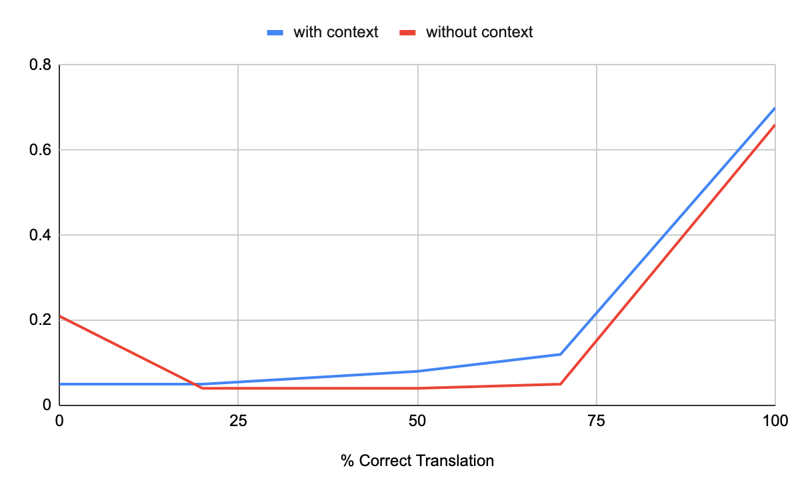
Statistics for % of sequence correct
Incorrect (0%) higher without context
Partial predictions(25%, 50%, 75%) higher with context

Slide 46
CONCLUSION

Slide 47
Conclusion
Image localization with the contextual information of image explored
RNN used in the project as dealing with sequences
Model with context seems to perform better
4% better accuracy when context is taken into consideration
model trained with the image context makes partial translations 12% better as compared to the model trained without the image context.
Can be used in other areas where context information not considered currently [34]
Old manuscripts
Sign boards and posters

Slide 48
FUTURE WORK

Slide 49
Future Work
Experiment with increased dataset
Experiment with different model architectures and parameters
More epochs
Different learning rate
Different Layers – LSTM , Bidirectional
Different activation functions
Different number of neurons
Can explore in other areas
Sign boards and posters
Old manuscripts

Slide 50
REFERENCES

Slide 51
References
[1] J.Y. Zhu, et al., “Unpaired Image-to-image Translation sing Cycle-Consistent Adversarial Networks,” in IEEE Int. Conf. on Comp. Vision, 2017. doi: 10.1109/ICCV.2017.244.
[2] R. Agarwal, Deep Learning Based OCR for Text in the Wild, https://nanonets.com/blog/deep-learning-ocr/
[3] B. Shi, X. Bai and C. Yao, “An End-to-End Trainable Neural Network for Image-based Sequence Recognition and Its Application to Scene Text Recognition”. doi: arXiv:1507.05717v1
[4] S. Saini and V. Sahula, “A Survey of Machine Translation Techniques and Systems for Indian Languages,” in IEEE Int. Conf. on Comp. Int. & Comm. Tech., 2015.
[5] H.A. Driss, S. ELFKIHI and A. Jilbab, “Features Extraction for Text Detection and Localization,” in 5 th Int. Symp. On I/IV Comm. And Mobile Network, 2010.
[6] C.M. Thillou and B. Gosselin, Natural Scene Understanding, https://www.tcts.fpms.ac.be/publications/regpapers/2007/VS_cmtbg2007.pdf
[7] X. Zhou, et al., “EAST: An Efficient and Accurate Scene Text Detector,” 1704.03155v2 [cs.CV] 10 Jul 2017.
[8] E. Charniak, Introduction to Deep Learning, ISBN: 9780262039512192 pp. | 7 in x 9 in75 b&w illus. January 2019.
[9] O. Rippel and L. Bourdev, “Real-Time Adaptive Image Compression,” The 34th Int. Conf. on Mach. Learn., 2017. doi: arXiv:1705.05823v1.
[10] G. Toderici et al., “Full Resolution Image Compression with Recurrent Neural Networks,” arXiv e-prints.,2016. doi: arXiv:1608.05148.

Slide 52
References
[11] T. Law, H. Itoh and H. Seki, “A neural-network assisted Japanese-English machine translation system,” in Proceedings of 1993 Int. Conf. on Neural Networks.
[12] Md. M. Hossain, K.E.U Ahmed and A.R Uddin, “English to Bangla Translation in Structural Way Using Neural Networks,” in 2009 Int. Conf. on Information and Multimedia Tech.
[13] A. Rosebrock, Non-Maximum Suppression for Object Detection in Python, https://www.pyimagesearch.com/2014/11/17/non-maximum-suppression-object-detection-python/
[14] R. Agarwal, Object Detection: An End to End Theoretical Perspective, https://towardsdatascience.com/object-detection-using-deep-learning-approaches-an-end-to-end-theoretical-perspective-4ca27eee8a9a
[15] C. Woodford, Optical character recognition (OCR), https://www.explainthatstuff.com/how-ocr-works.html
[16] D.G. Lowe, “Object recognition from local scale-invariant features,” in Proceedings of the 1999 IEEE Int. Conf. on Computer Vision.
[17] M. Unser, “Texture classification and segmentation using wavelet frames,” IEEE Transactions on Image Processing, Vol. 4, Issue: 11, Nov 1995.
[18] O. Vinyals, “Show and tell: A neural image caption generator,” in 2015 IEEE Int. Conf. on Comp. Vision and Pattern Recognition.
[19] T. Tracey, Language Translation with RNNs, https://towardsdatascience.com/language-translation-with-rnns-d84d43b40571
[20] H. Lamba, Image Captioning with Keras, https://towardsdatascience.com/image-captioning-with-keras-teaching-computers-to-describe-pictures-c88a46a311b8

Slide 53
References
[21] RNN neuron from https://en.wikipedia.org/wiki/Recurrent_neural_network
[22] Google Translate, https://translate.google.com/
[23] Train and Test Images, https://en.wikipedia.org
[24] G. Shpreber, A gentle introduction to OCR, https://towardsdatascience.com/a-gentle-introduction-to-ocr-ee1469a201aa
[25] S. Banerjee, An Introduction To Recurrent Neural Networks, https://medium.com/explore-artificial-intelligence/an-introduction-to-recurrent-neural-networks-72c97bf0912
[26] M. Nguyen, Illustrated Guide to LSTM’s and GRU’s: A step by step explanation, https://towardsdatascience.com/illustrated-guide-to-lstms-and-gru-s-a-step-by-step-explanation-44e9eb85bf21
[27] A Beginner's Guide to Word2Vec and Neural Word Embeddings, https://skymind.ai/wiki/word2vec
[28] What is Tesseract and how it works?, https://medium.com/@Bytepace/what-is-tesseract-and-how-it-works-dfff720f4a32
[29] Google Cloud Vision, https://cloud.google.com/vision/
[30] Microsoft Bot, https://dev.botframework.com/

Slide 54
References
[31] Google Colaboratory, https://colab.research.google.com/
[32] https://github.com/tommytracey/AIND-Capstone
[33] J. Brownlee, Gentle Introduction to the Adam Optimization Algorithm for Deep Learning, https://machinelearningmastery.com/adam-optimization-algorithm-for-deep-learning/
[34] K. Mokhtar, S.S. Bukhari and A.Dengel, “OCR Error Correction: State-of-the-Art vs an NMT-based Approach,” in 13th IAPR Int. Workshop On Document Analysis Sys., 2018.

Slide 55
THANK YOU

